Slide 1

GRADIENT DESCENT & OPTIMIZATION

Slide 2

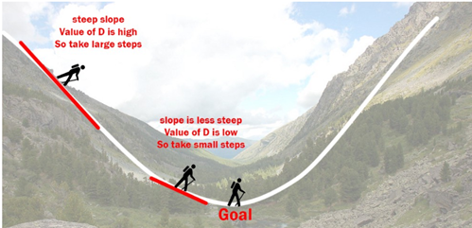
INTRODUCTION TO GRADIENT DESCENT
The Gradient Descent Algorithm
Gradient descent is an iterative optimization algorithm to find the minimum
of a function. Here that function is our Loss Function.

Slide 3
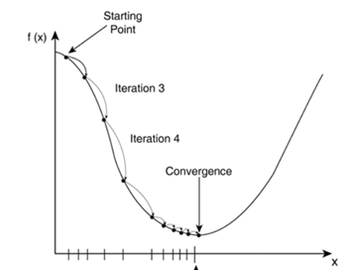
INTRODUCTION TO GRADIENT DESCENT
The Gradient Descent Algorithm
Gradient descent is an iterative optimization algorithm to find the minimum
of a function. Here that function is our Loss Function.

Slide 4
INTRODUCTION TO GRADIENT DESCENT
But where is the advantage?

Slide 5
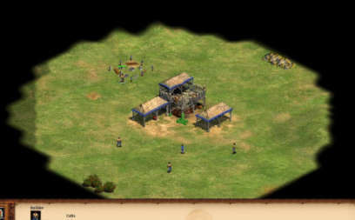
INTRODUCTION TO GRADIENT DESCENT
But where is the advantage?

Slide 6
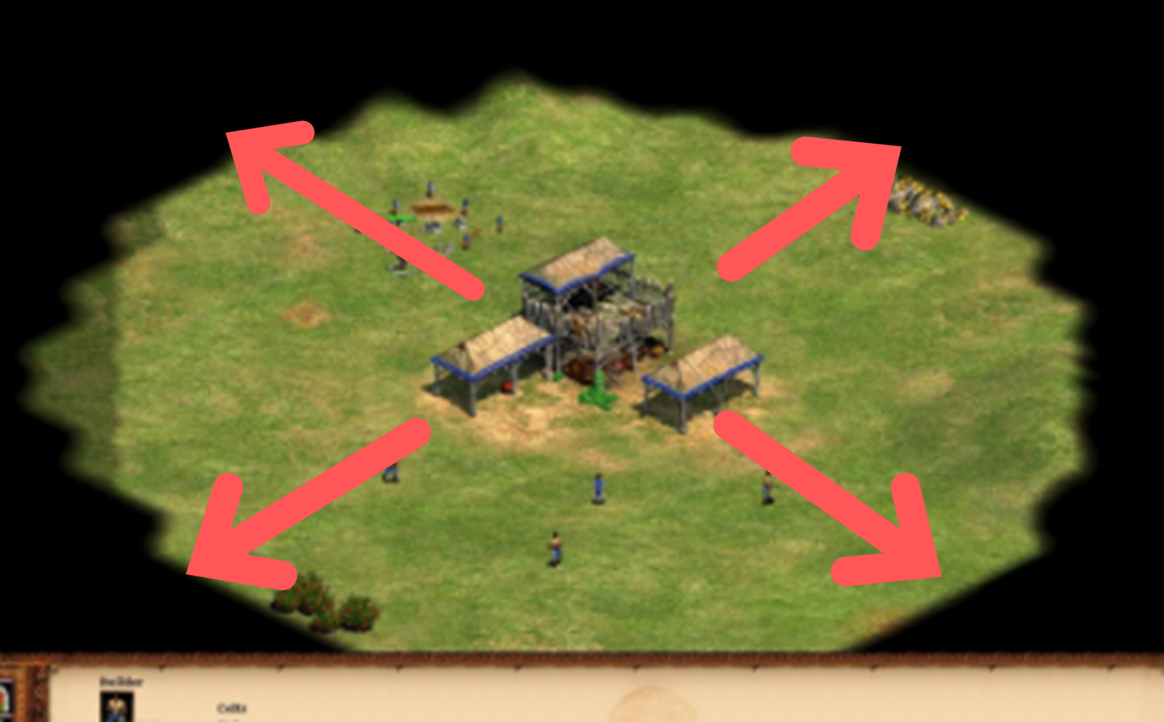
INTRODUCTION TO GRADIENT DESCENT
But where is the advantage?

Slide 7
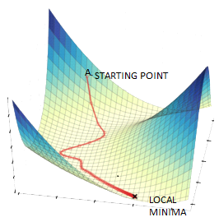
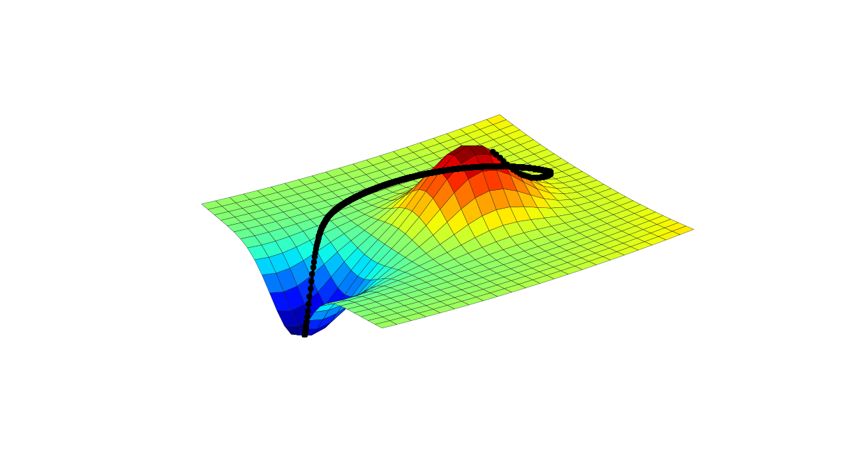
INTRODUCTION TO GRADIENT DESCENT

Slide 8
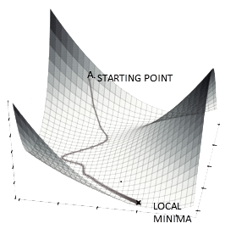


INTRODUCTION TO GRADIENT DESCENT

Slide 9
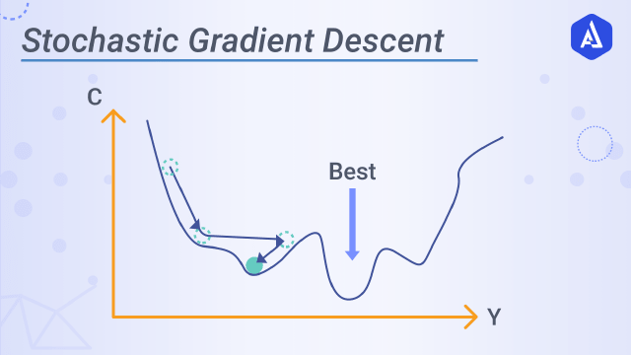
INTRODUCTION TO GRADIENT DESCENT

Slide 10

THE ALGORITHM
The algorithm of Gradient descent is therefore:
1. Guess an initial value of the parameter
2. Evaluate the function you want to minimize at that point
3. Compute the gradient of the function at that point
4. Shift the parameter value in the direction of decreasing gradient
5. Repeat process until convergence criteria is met

Slide 11
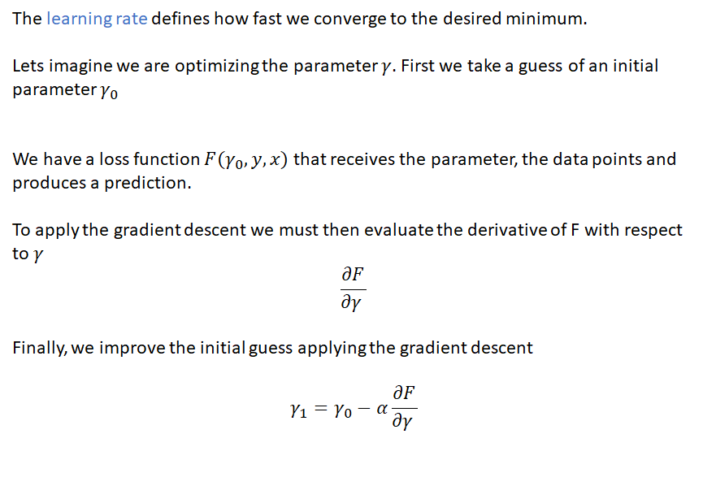
THE ALGORITHM
The learning rate defines how fast we converge to the desired minimum.
Lets imagine we are optimizing the parameter y. First we take a guess of an initial parameter Yo
We have a loss function F(Yo, y,x) that receives the parameter, the data points and produces a prediction.
To apply the gradient descent we must then evaluate the derivative of F with respect to ɣ
descent gradient the applying guess initial the improve weFinally,

Slide 12
THE ALGORITHM
The learning rate defines how fast we converge to the desired minimum.
Lets imagine we are optimizing the parameter y. First we take a guess of an initial parameter Yo
We have a loss function F(Yo, y,x) that receives the parameter, the data points and produces a prediction.
To apply the gradient descent we must then evaluate the derivative of F with respect to ɣ
a is the learning rate, and defines how big a jump we will give in the optimization parameter.
descent gradient the applying guess initial the improve weFinally,
Exam Type Question: What are the consequences of a large/small value of a?

Slide 13
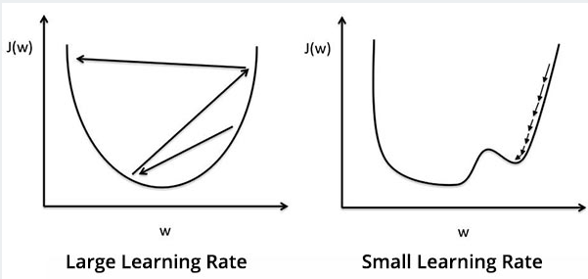
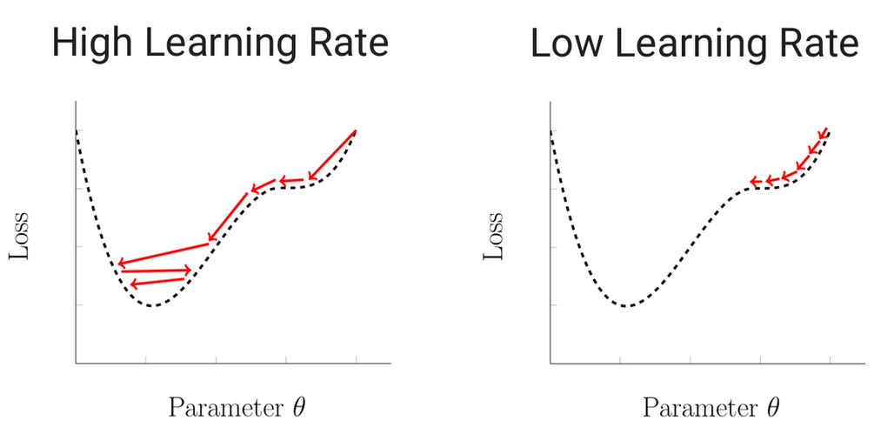
THE ALGORITHM

Slide 14

THE ALGORITHM
There are two usual types of convergence criteria used:
1. Convergence after a certain error boundary limit is reached.
Example: whenever the values of my loss function is smaller
than 0.001
2. Convergence after a fixed number of iterations.
Example: Improve parameter 10000 times and then exit.

Slide 15
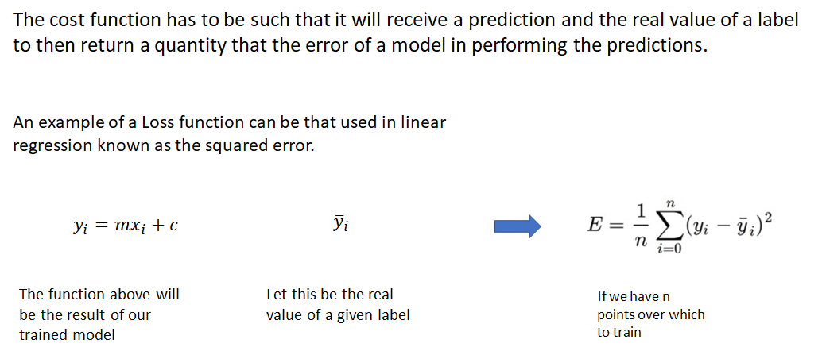
THE ALGORITHM
The cost function has to be such that it will receive a prediction and the real value of a label
to then return a quantity that the error of a model in performing the predictions.
An example of a Loss function can be that used in linear
regression known as the squared error.
The function above will
be the result of our
trained model
Let this be the real
value of a given label
If we have n
points over which
to train

Slide 16
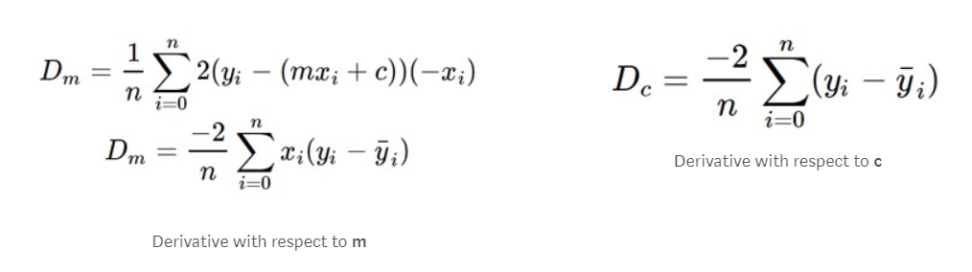
EXAMPLE FOR LINEAR REGRESSION

Slide 17

ANY QUESTIONS ?

